Slide 1
Week 2 Thursday
Analyzing Big Data II

Slide 2
Logistic Regression

Slide 3
Logistic Regression
Extends idea of linear regression to situation where outcome variable is categorical
Dichotomous vs. Multinomial
Examples:
Classifying customers as churn or not-churn (classification)
Finding factors that differentiate between male and female top executives (profiling)
Predicting the approval & disapproval of a loan based on information such as credit scores (classification)

Slide 4
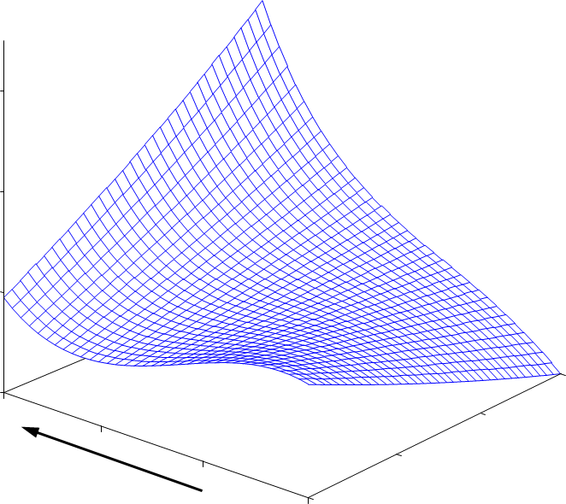
The Fallacy of Univariate Thinking
What is the most important cause of churn?
Prob(churn)
International
Usage
Daytime
Usage

Slide 5
The Logit
Goal: Find a function of the predictor variables that relates them to a 0/1 outcome
Instead of Y as outcome variable (like in linear regression), we use a function of Y called the logit
Logit can be modeled as a linear function of the predictors
The logit can be mapped back to a probability, which, in turn, can be mapped to a class

Slide 6
The Logit
Logit(p/1-p) =
The odds of an event are defined as:
p = probability of event
Or, given the odds of an event, the probability of the event can be computed by:

Slide 7
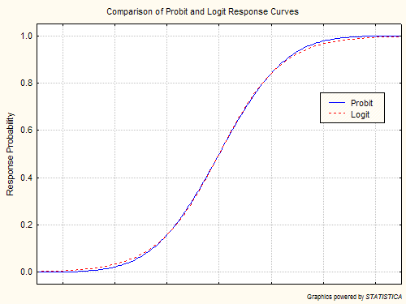
Logistic Regression
Odds of success
= p / (1-p) = p / q
Logit = log(p/q)
Logit transformation allows for a linear model
If β is the coefficient in a logistic output, can find odds = e^{β}
If whole model = L = β₀ + β₁ X₁ + β₂ X₂ + …
Then p = e^{L} / (1 + e^{L})

Slide 8
Interpreting Odds, Probability
For predictive classification, we typically use probability with a cutoff value
For explanatory purposes, odds have a useful interpretation:
If we increase x₁ by one unit, holding x₂, x₃ … x_{q} constant, then
b₁ is the factor by which the log(odds) of belonging to class 1 increase

Slide 9
Multinomial Logistic Regression
#Read data file
mydata<-read.csv(“your data directory path/Betting.csv")
#Multinomial Logistic regression
library(nnet)
mydata$prog2<-relevel(mydata$Match_O, ref="Loss")
test<-multinom(prog2~HTGD+RED.H+RED.A+POINTS_H+POINTS_A+TOTAL_H_P+TOTAL_A_P+FGS.0+FGS.1,
data=mydata)
summary(test)
#2-tailed z test
z <- summary(test)$coefficients/summary(test)$standard.errors
p <- (1 - pnorm(abs(z), 0, 1)) * 2
p
#Exponentiate
exp(coef(test))

